Slide 1
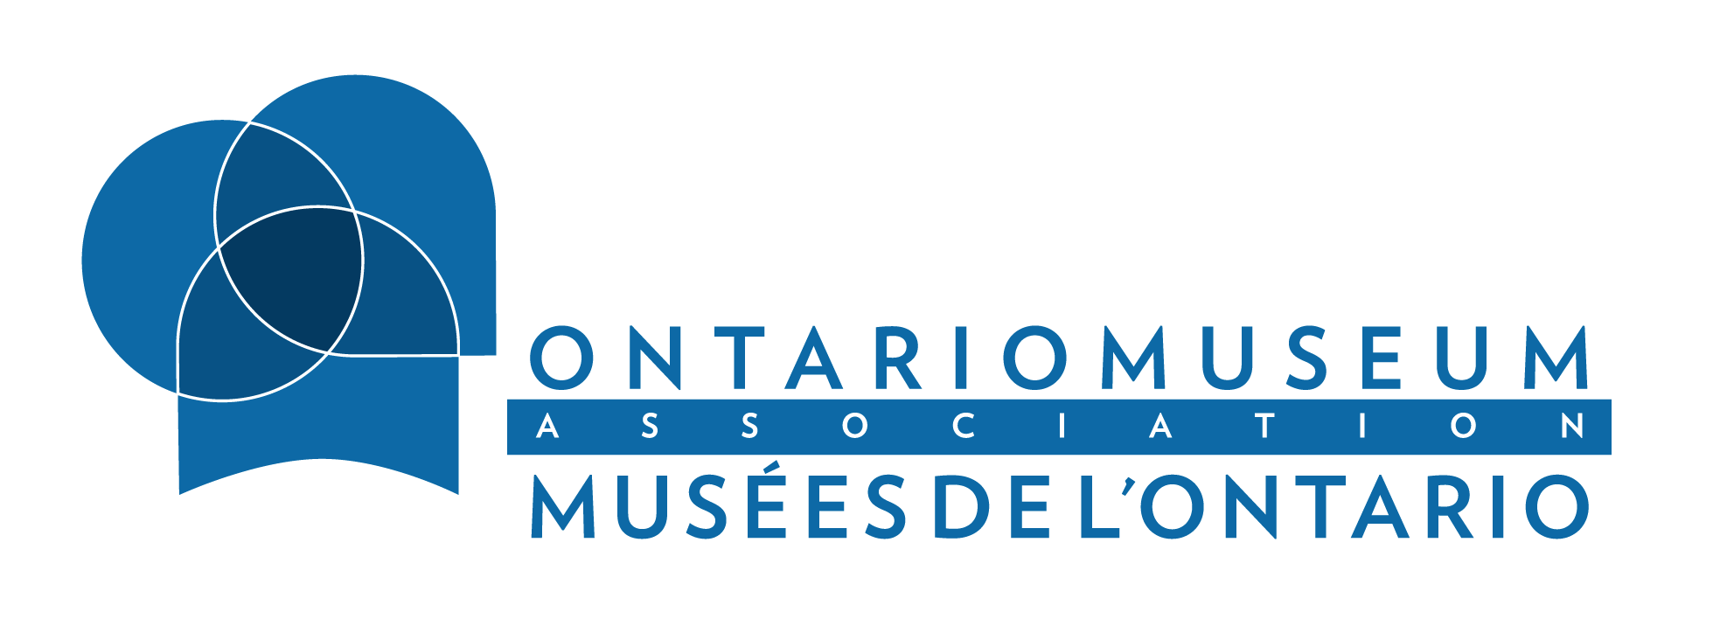

Saving Ontario’s Museums
A Post-Pandemic Recovery Strategy: Recommendations for Ontario’s 2022 Budget
Marie Lalonde
Executive Director, Ontario Museum Association
7 February 2022

Slide 2


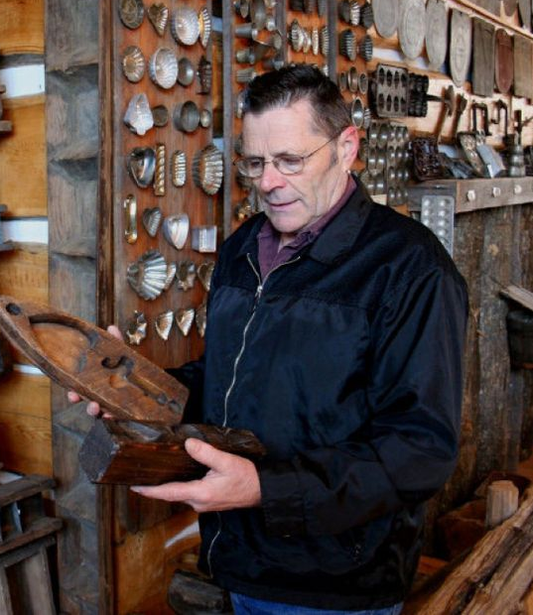
The faces of Ontario’s museums:
Meet Sarah, a volunteer visitor assistant at the Royal Ontario Museum in Toronto.
Meet Michael, an 11-year-old student in Ottawa who loves the dinosaurs at the Canadian Museum of Nature.
Meet Roger, a 57-year-old administrative assistant at the Maple Syrup Museum of Ontario in St. Jacobs.

Slide 3
What Ontario’s museums do for the province:
provide equity, accessibility, and community well-being to people who rely on museums but are essential to their operation
provide education opportunities essential to the province’s more than 2 million school children
provide job security for people who rely on the sector for employment

Slide 4
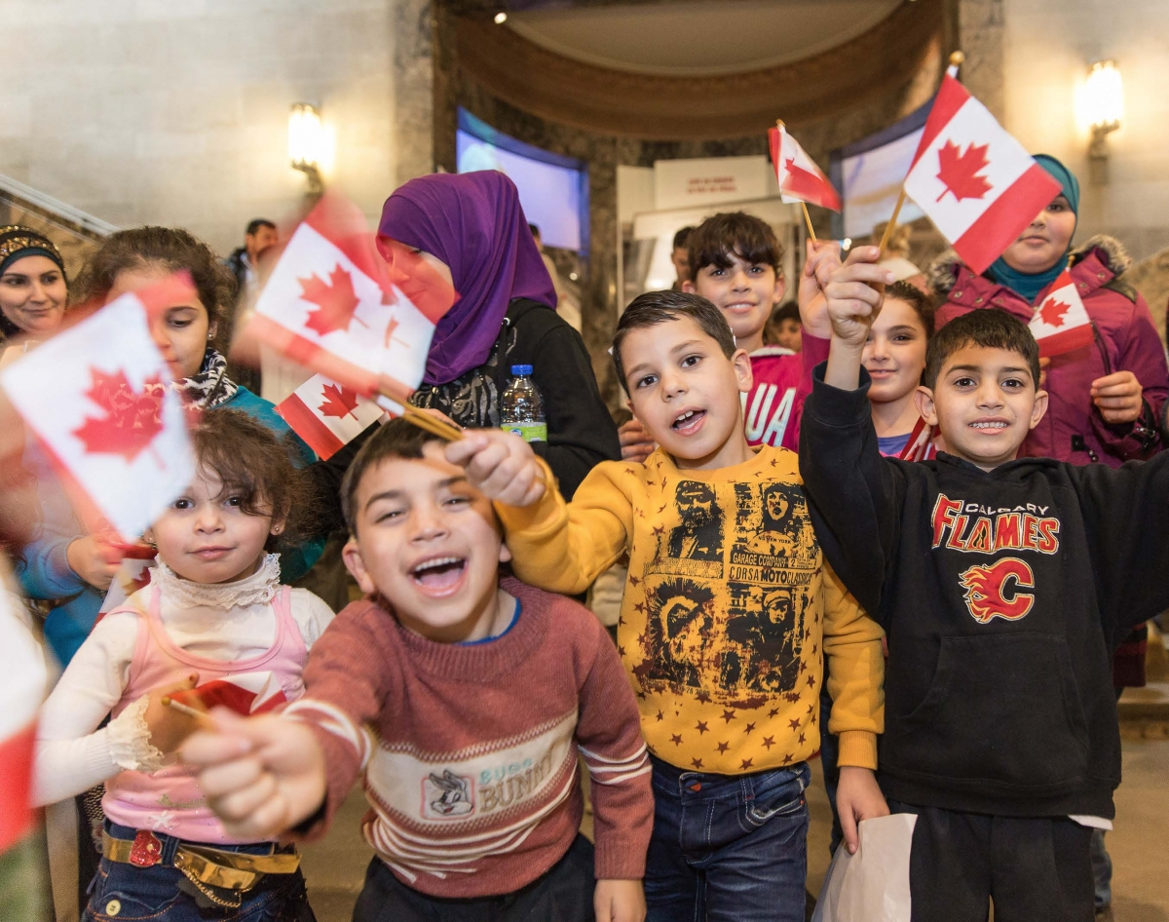
The value of museums to Ontario:
$1.6 billion in revenue
$600 million from school trips
11,000+ jobs
protecting and promoting the province’s heritage
telling our stories and creating a sense of community
building partnerships with other industries like education and tourism
School children new to Canada at a Canoo event day at the Royal Ontario Museum

Slide 5
The problems before
the pandemic:
a closed program for funding, preventing museums from accessing support
a reliance on short-term project funding
outdated standards of assessment that don’t reflect current best practices in museums
a lack of sufficient provincial funding
How the pandemic made these problems worse:
closures and cancellations (including during the busy summer season) have meant more than $120 million in losses
closures have damaged opportunities for community outreach
museums are struggling with decreased occupancy allowances
funds to pivot programming online are insufficient
visitors are losing confidence, trust, and interest in museums
Only ¼ of museums have the funds for this year

Slide 6

What the Government of Ontario can do to help museums rebuild:
3 recommendations for Ontario’s 2022 Budget:
1. An Ontario Museum Relief Fund of 10 million dollars, to support museums during future closures.
2. A Digital Response Fund of 10 million dollars, to help museums build robust online experiences in programming and education
3. 10 million dollars for smaller, community museums across the province
Notes:
What can the Government of Ontario do to help museums rebuild?
The Ontario Museum Association proposes a concrete and actionable strategy.
[Appear 1] On the basis of an audit of Ontario’s museums, conducted in collaboration with the Office of the Auditor General of Ontario, we propose three targeted recommendations be added to Ontario’s 2022 Budget.
1. an Ontario Museum Relief Fund of 10 million dollars, to address museums’ financial needs and support them during any future periods of closure
2. a Digital Response Fund of 10 million dollars, over three years, to help museums build robust online experiences in programming and education that provide the necessary alternative means for museums to communicate and collaborate with their communities and audiences
3. increased support of 10 million dollars a year for smaller, community museums across the province, to allow under-funded institutions to stabilize and recover
[Appear 2] These recommendations will also require a new museum funding model that introduces a consistent eligibility criteria.
[Appear 3] And they will depend on a process of transparent and mutually supportive collaboration between the province and our organization.
The financial support that our recommendations outline will help museums recover so that they can continue to serve our communities and contribute to rebuilding Ontario’s post-pandemic economy.

Slide 7
Save Ontario’s museums!
Invest in Ontario’s future by investing in our heritage.
Thank you
Notes:
The Ontario Museum Association is dedicated to the future and prosperity of the province for its people, its communities, its heritage, and its economy.
We ask the Government of Ontario to invest in the future of the province by investing in our heritage.
We look forward to working with you, and to helping rebuild the province’s economy by saving one of its most vital industries: our museums.
Thank you.

