Slide 1

GETTING STARTED
WITH
EMILY LOUGHNAN
11 February 2022

Slide 2
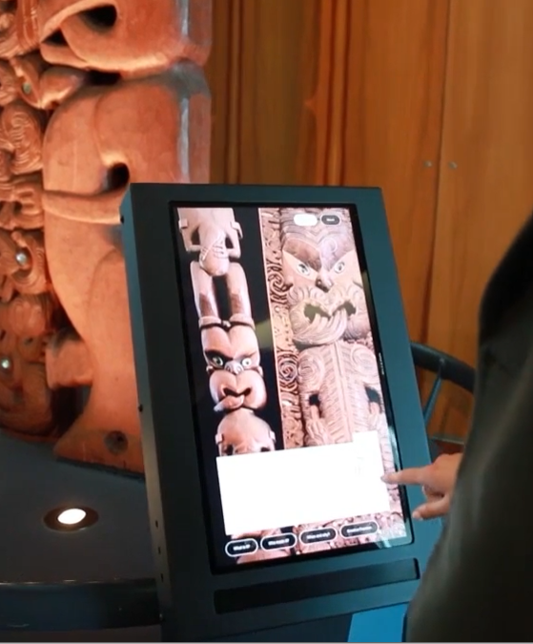
HOW DO YOU USE CURIO?
Today we’ll touch on:
1. How to start a new project.
2. What a Hero Image is and how to choose one.
3. How to navigate some of the main features of the program interface, including the Project Menu.
Let’s get started!

Slide 3
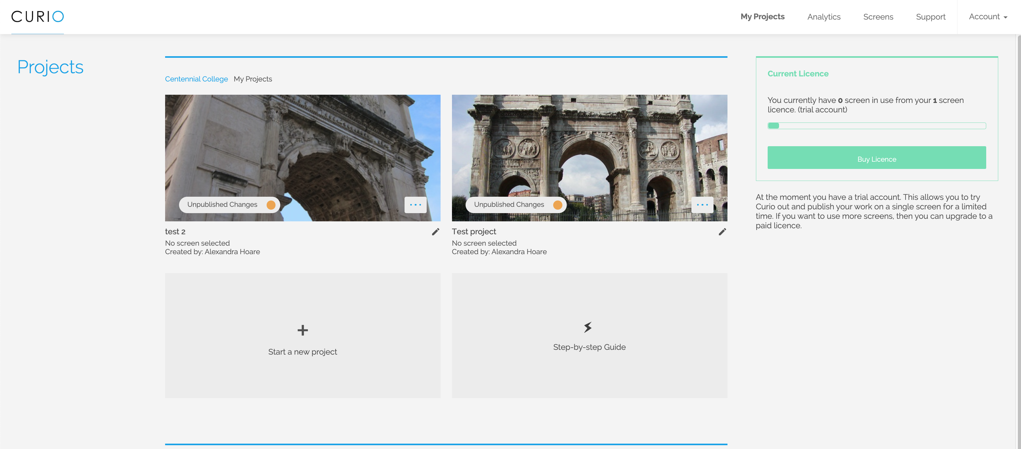
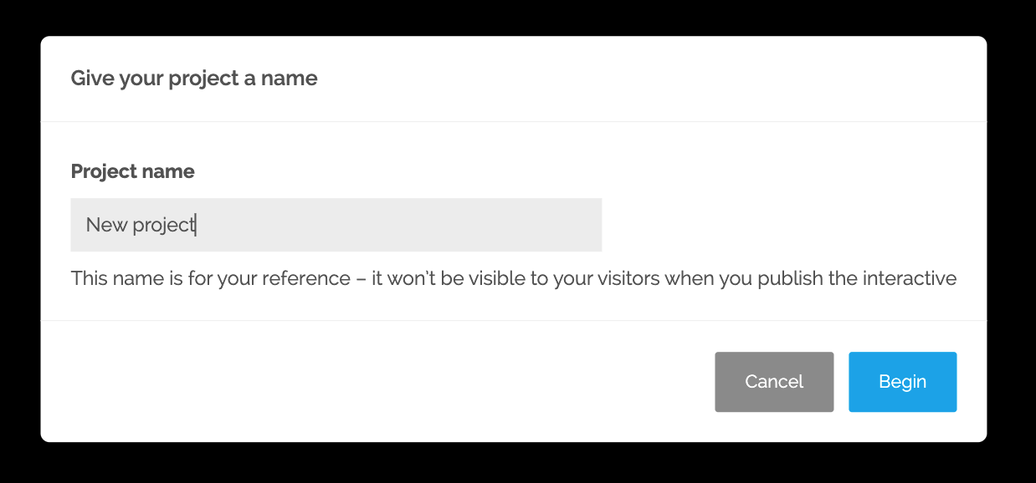
My Projects page

Slide 4
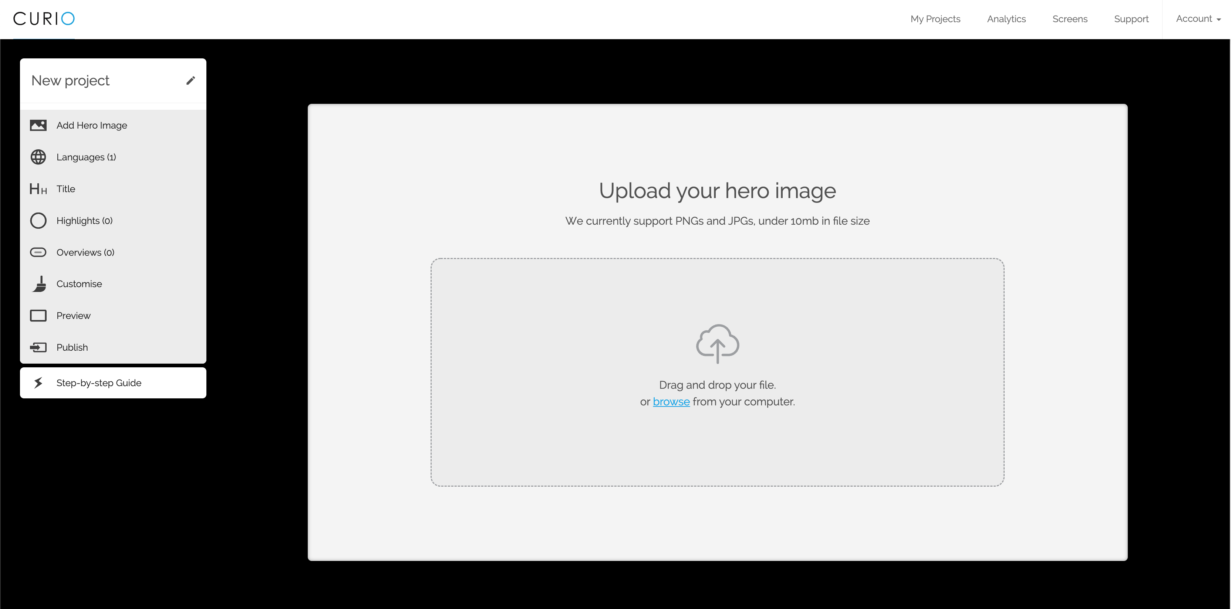
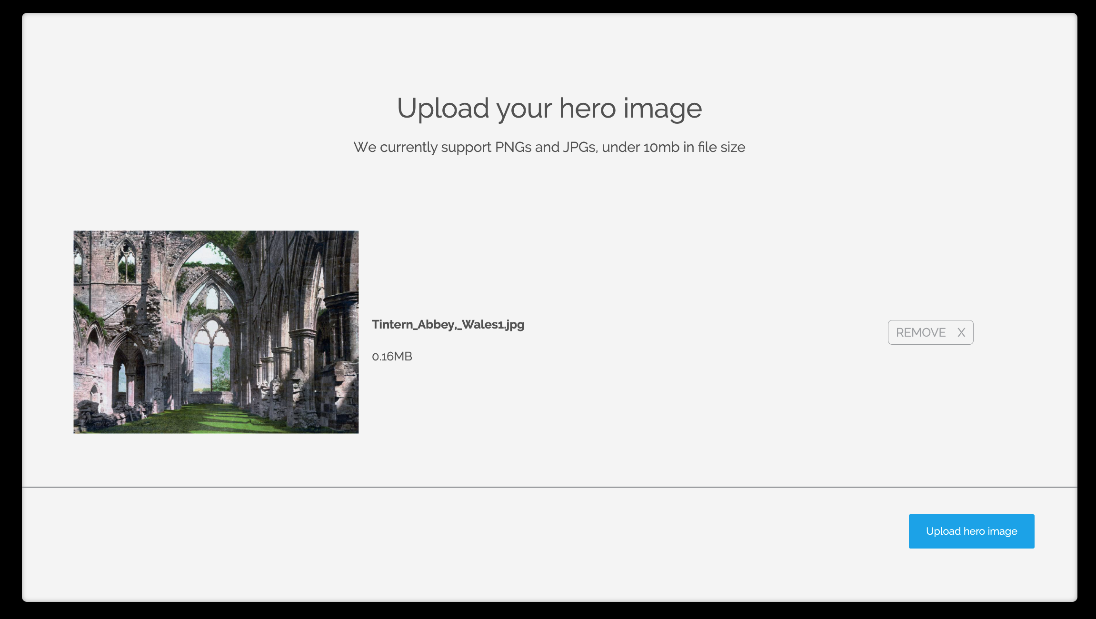
High-resolution (10 mb max.)
Jpeg or png

Slide 5
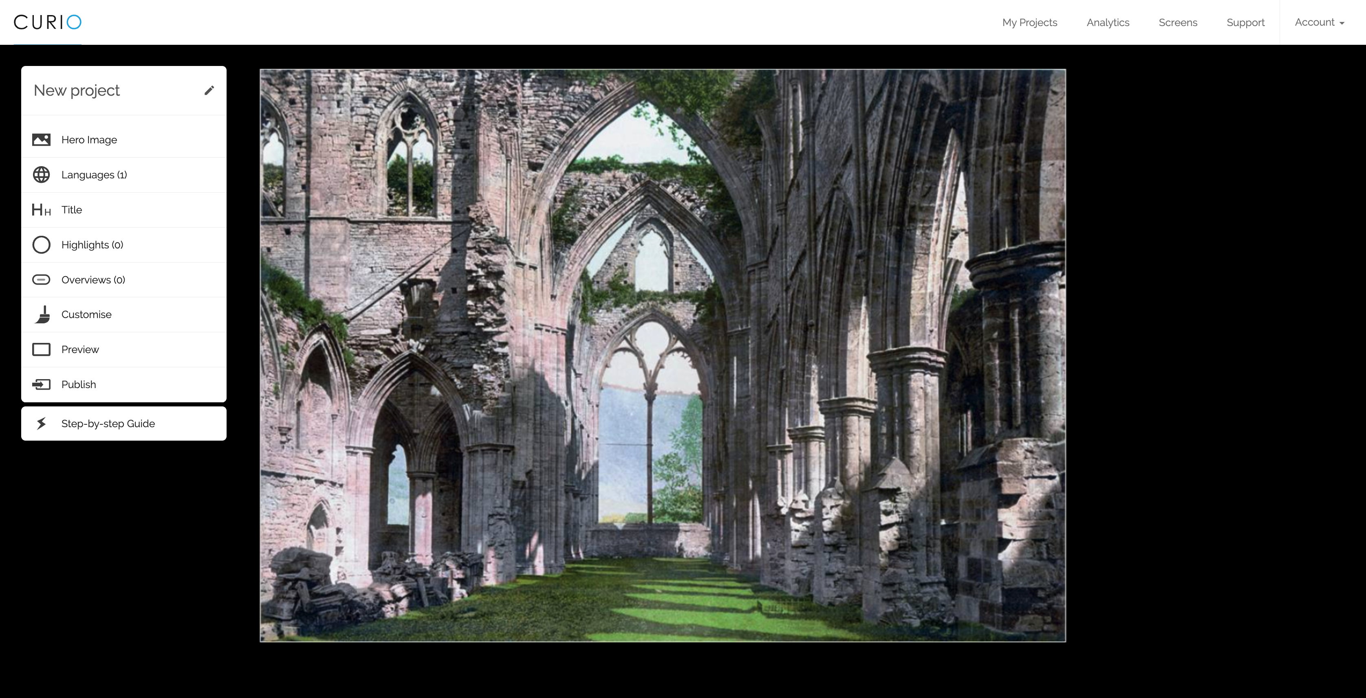
interactive

Slide 6
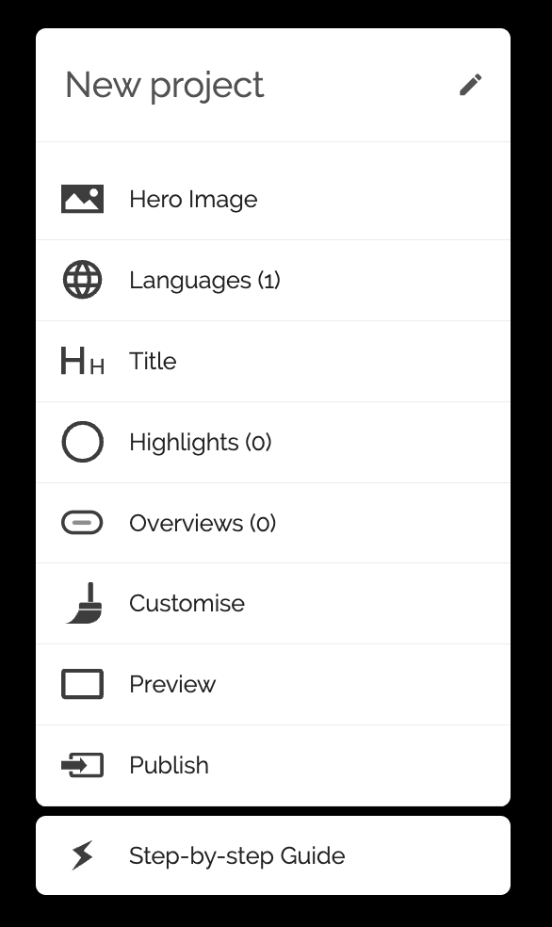
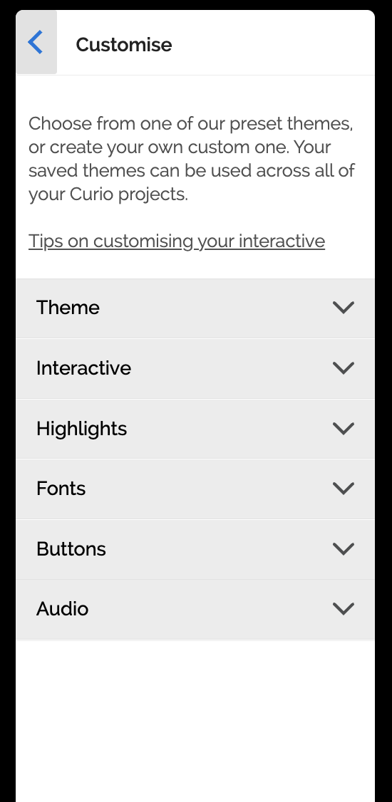
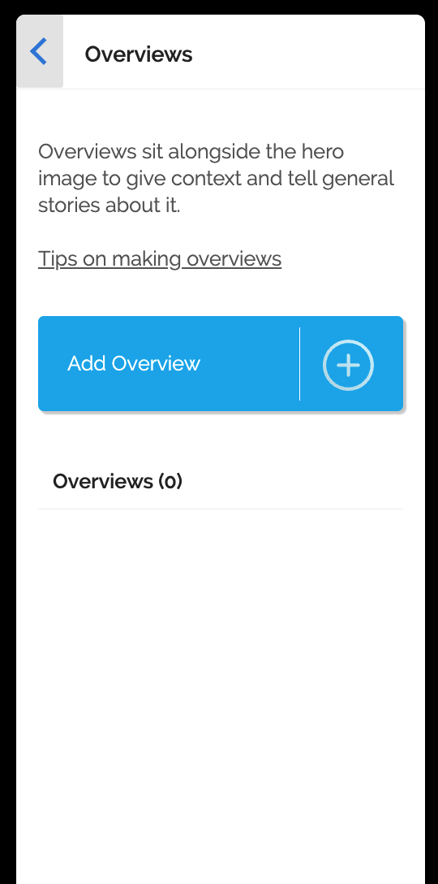
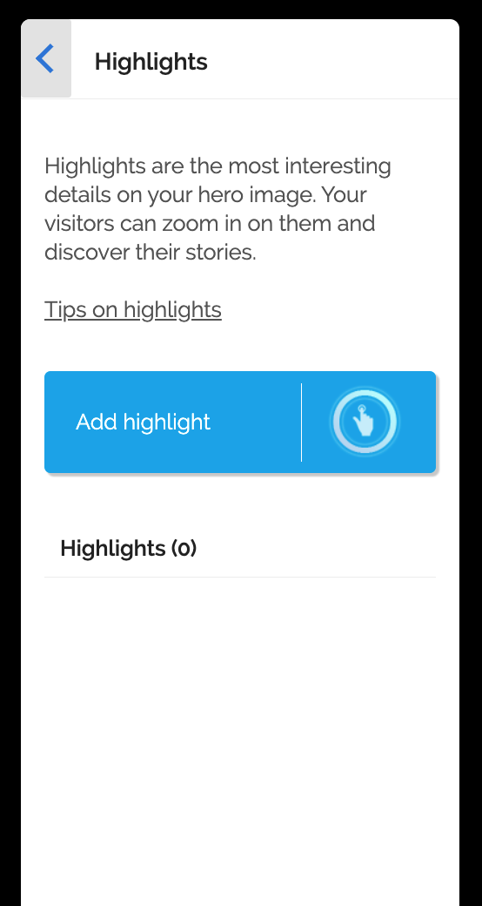
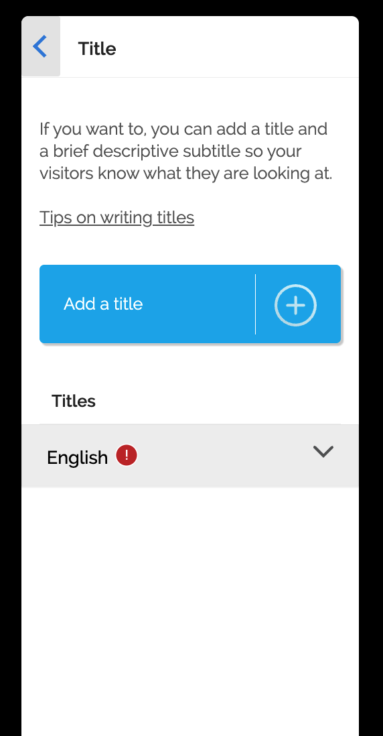
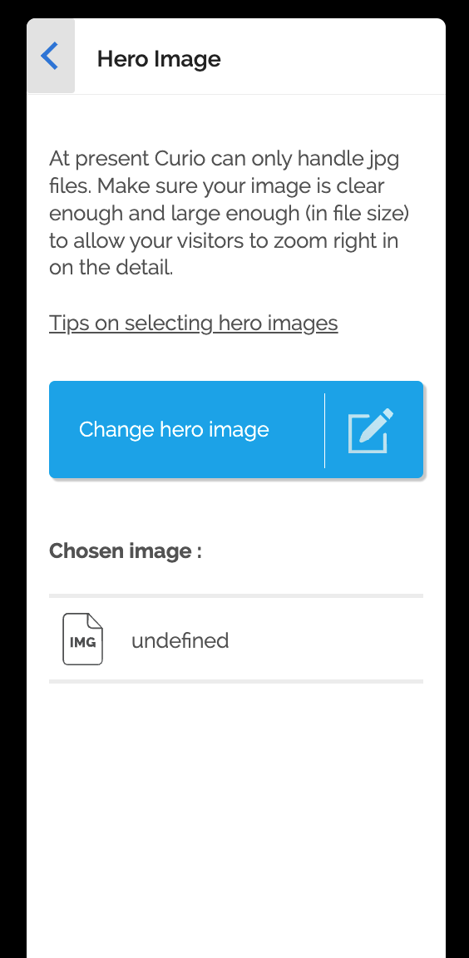
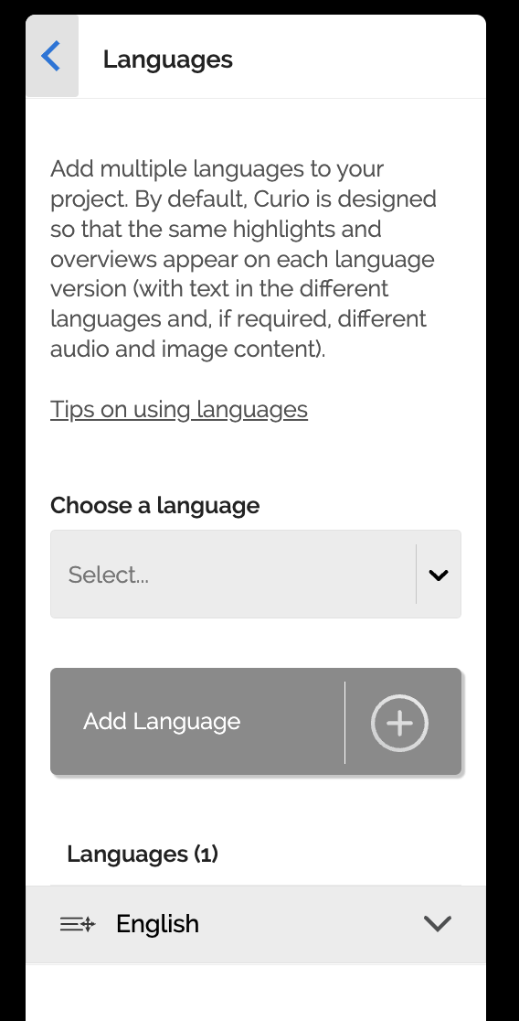

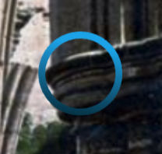
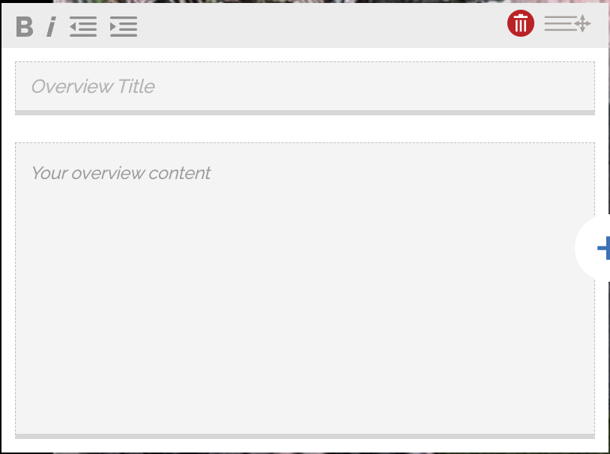

Slide 7
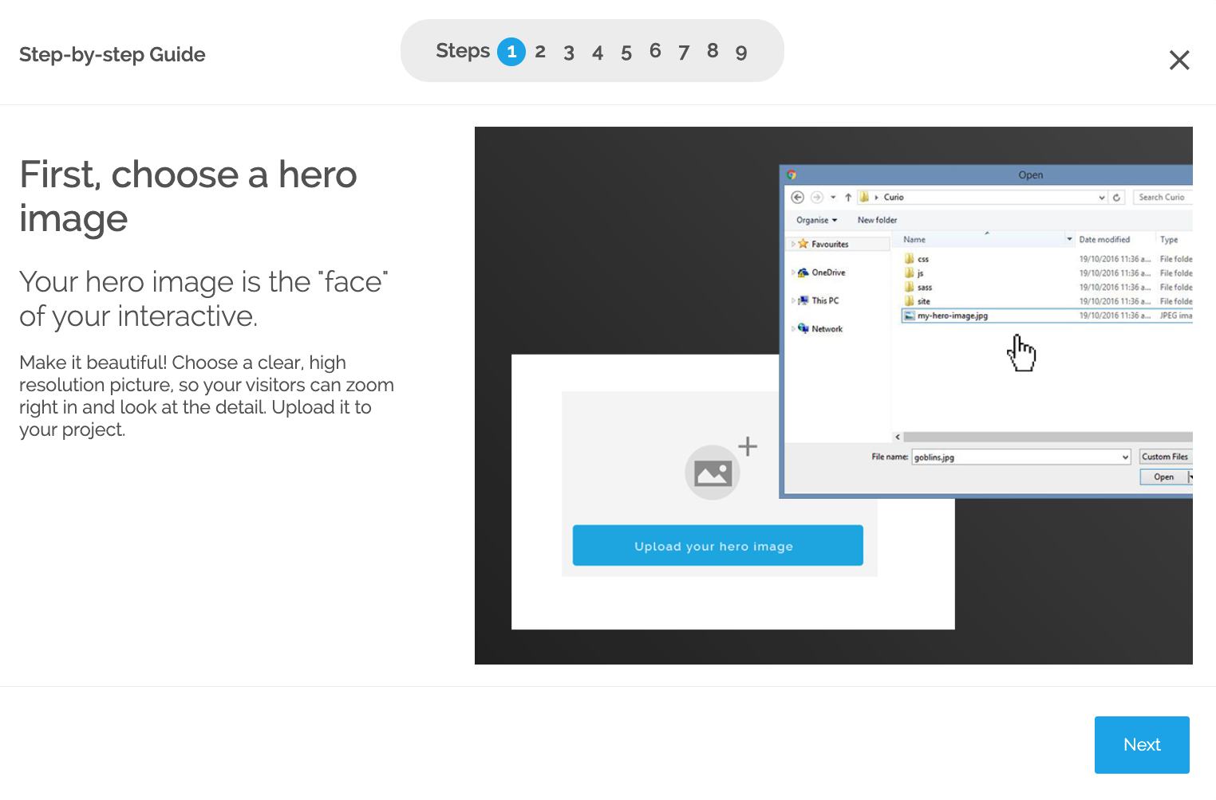

Slide 8
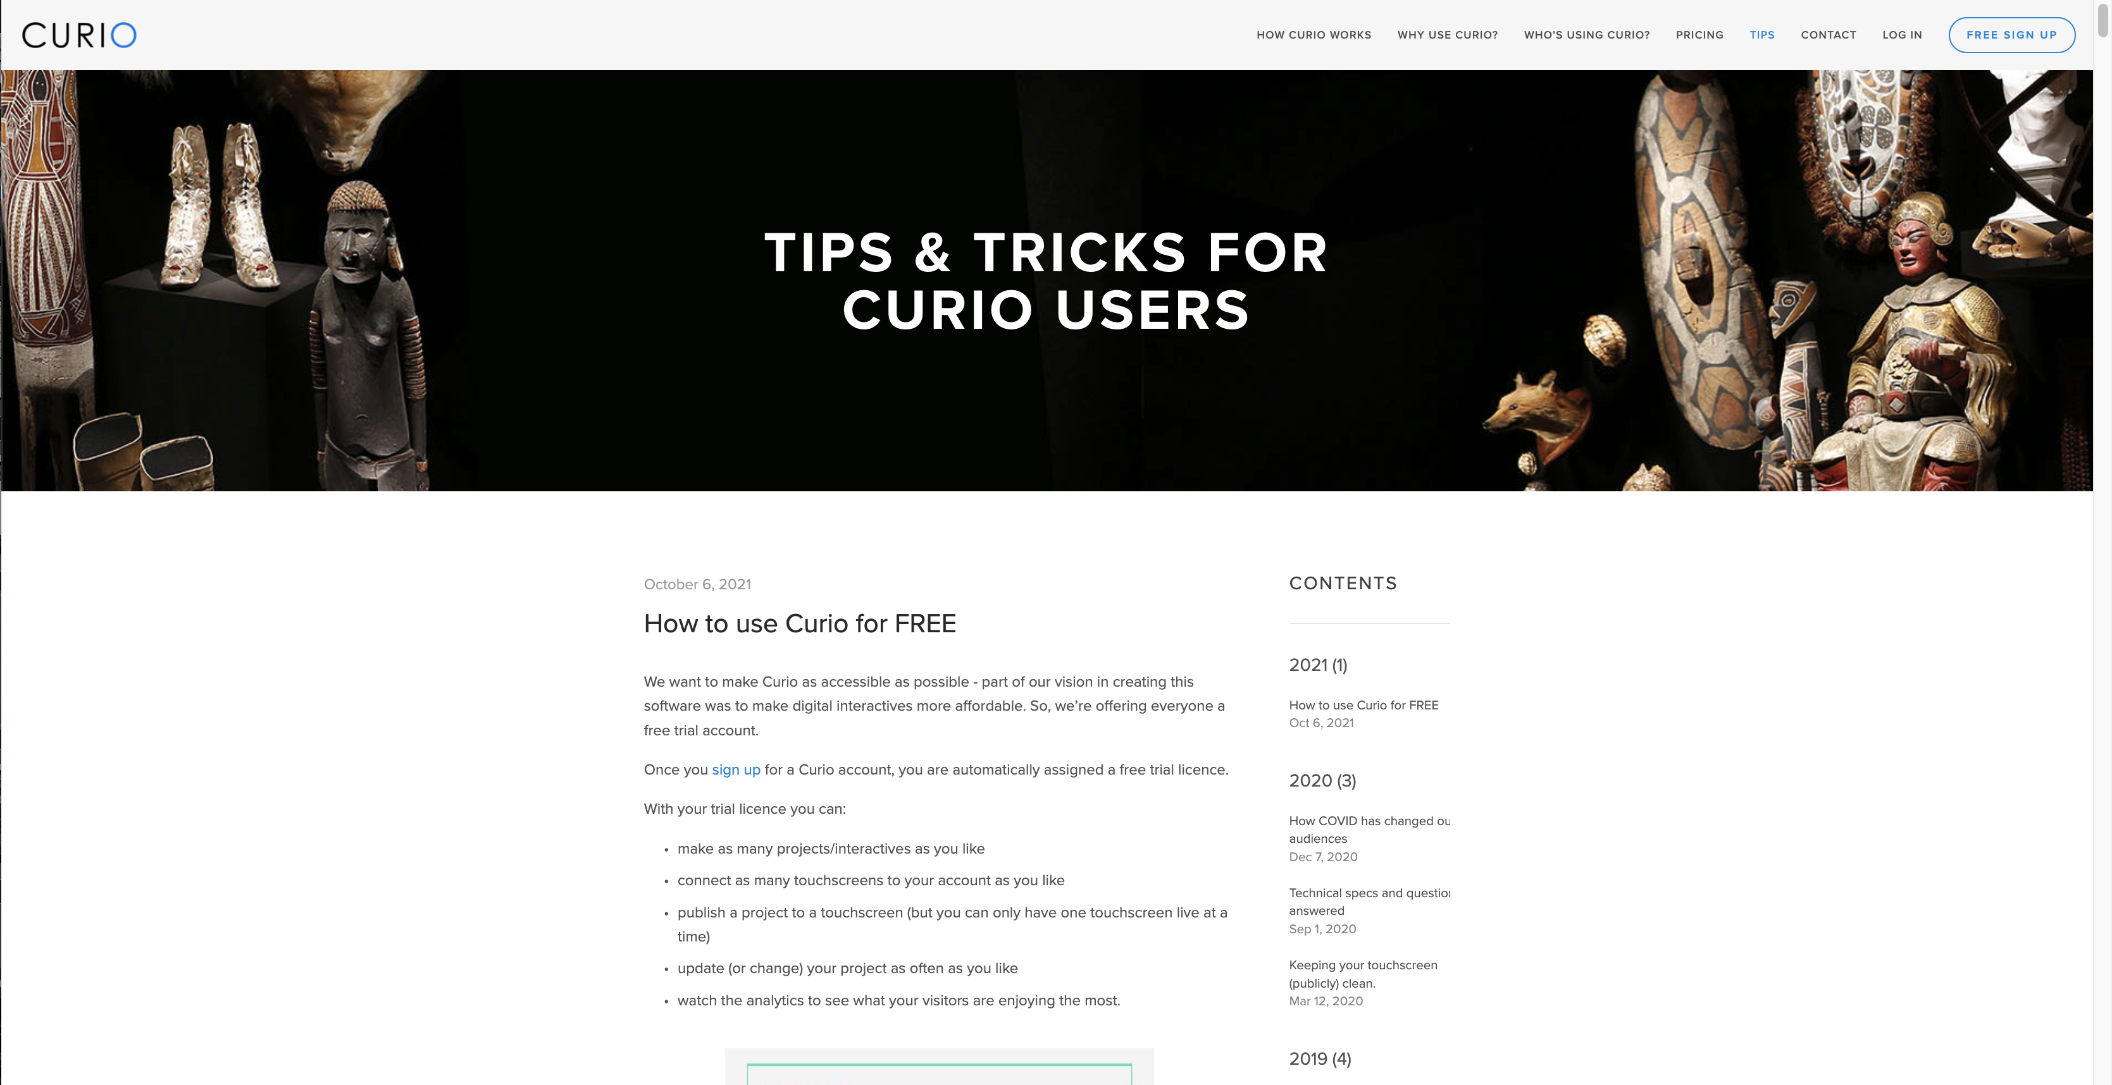
curiopublisher.com

Slide 9
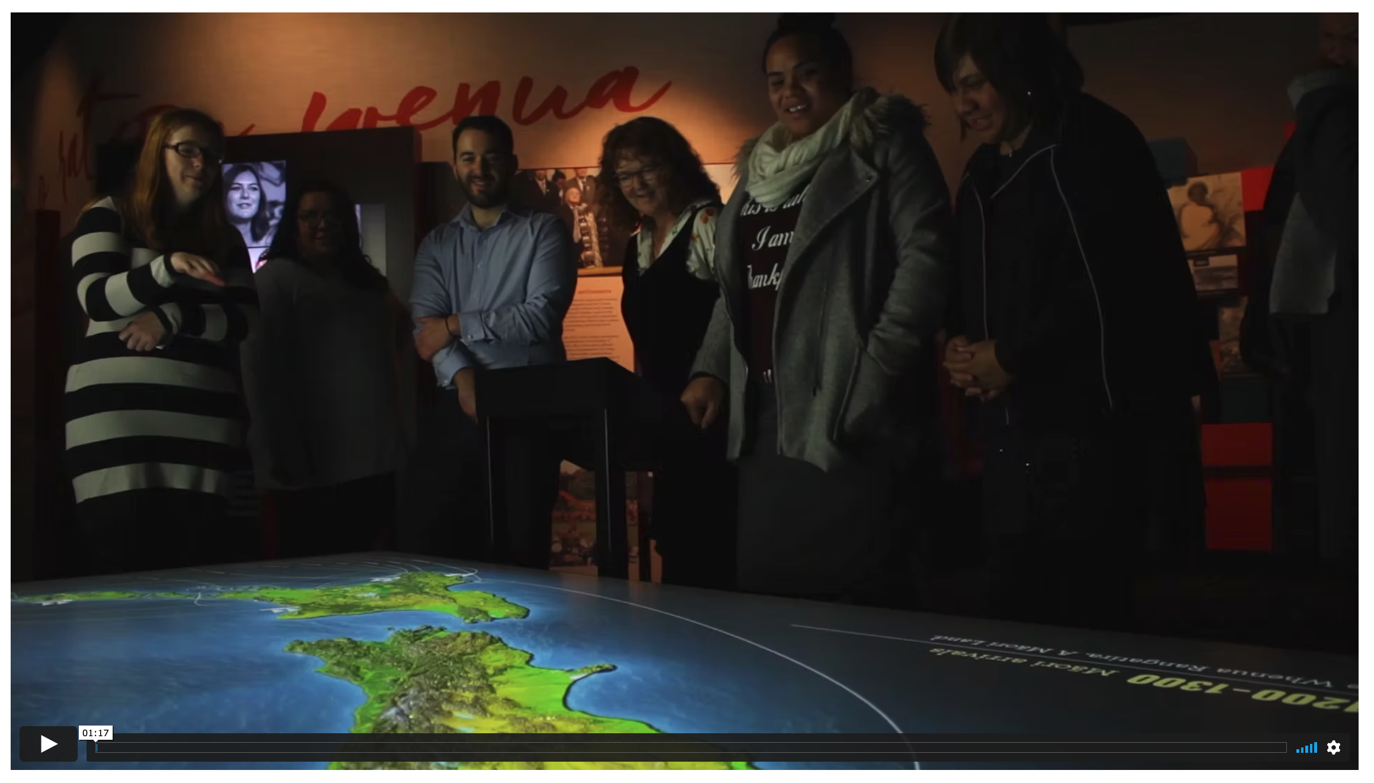
He Tohu: An Interactive Map Table
http://www.clicksuite.co.nz/work/hetohu-maptable/

Slide 10
QUICK QUIZ!
What is a “hero image”?
What is an “interactive”?
What is a “highlight” and why might you want to create one?
Where can you find more help if you need it?

Slide 11
GET CREATIVE!
CURIO is here to help you tell your stories in a simple, unique, and engaging way
FEEL FREE TO ASK ANY QUESTIONS!
curiopublisher.com

