Slide 1
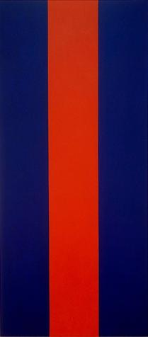
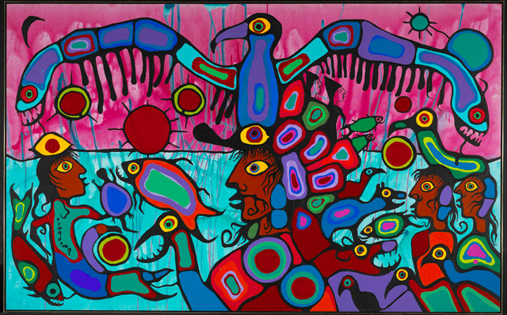
Understanding Abstract Art
Notes:
A very warm welcome to the National Gallery of Canada. My name’s Alex, and today I’m going to guide you in a lesson on understanding abstract art.
As part of our lesson, we’re going to look closely at some of the most interesting objects in the Gallery’s collection and learn how to interpret them.
You have under your chairs a package with a handout, post-it note, and pencil for you to use today in the gallery. We’re going to move about a little in the space today, so do whatever makes you comfortable.
In the first part of our lesson today, we’re going to spend some time with the two works of art you can see on the wall behind me. →

Slide 2
Norval Morrisseau
(Copper Thunderbird)
Indigenous
Notes:
→ The first one I want to share with you is this fascinating and very colourful painting, which was made by Norval Morrisseau, who is also known as Copper Thunderbird, one of the most important and influential 1. Indigenous artists in Canada. We’re going to learn a bit more about him in a minute.
But first, I want you to take a close look at this painting, while I share with you a few of the things that Morrisseau had to say about his own art.

Slide 3
I transmit astral plane harmonies through my brushes into the physical plane. These otherworld colours are reflected in the alphabet of nature, a grammar in which the symbols are plants, animals, birds, fishes, earth and sky. I am merely a channel for the spirit to utilize.
My art . . . transcend[s] barriers of nationality, language and other forces that may be divisive, fortifying the greatness of the spirit that has always been the foundation of the Ojibwa people.
I want to make paintings full of colour, laughter, compassion and love . . . paintings that will make people happy, that will change the course of people’s lives.
Notes:
1. I transmit astral plane harmonies through my brushes into the physical plane. These otherworld colours are reflected in the alphabet of nature, a grammar in which the symbols are plants, animals, birds, fishes, earth and sky. I am merely a channel for the spirit to utilize.
2. My art . . . transcend[s] barriers of nationality, language and other forces that may be divisive, fortifying the greatness of the spirit that has always been the foundation of the Ojibwa people.
3. I want to make paintings full of colour, laughter, compassion and love . . . paintings that will make people happy, that will change the course of people's lives.

Slide 4
Would you describe Morrisseau’s painting as abstract?
Why or why not?
Write your answer on your Post-it, then add it to the whiteboard!
Notes:
So, in looking closely at Morrisseau’s painting, and listening to what he has to say about his art, I have a question for you: 1. Would you describe Morrisseau’s painting as “abstract”? 2. Why or why not?
I’d like you to write your answer on your Post-it note and then come up and attach it to the whiteboard over here.
Don’t worry about being ‘right’ or ‘wrong’, because there are lots of different answers, as we’ll see later today!
[Pause]
Ok! Lots of great answers here! Some of you said you think the painting IS abstract, because the figures don’t quite look real. And others said the painting ISN’T abstract, because you can quite clearly see that there are people and animals.
You’re all correct! And we’re going to learn why in a minute.

Slide 5
representation
abstraction
is one type of representation
Notes:
One of the things that makes a work of art “abstract” is the way it 1. represents the things we can see with our eyes. 2. It’s a type of representation - that is, one of a number of different ways that an artist might represent or depict objects, ideas, or thoughts - things that are either part of our physical world or imagined.
What are some of the other ways that artists “represent” things or ideas?
[pause]
Yes, there are lots of different ways! And we use lots of different words to describe the different types of representation that artists use.
Today, we’re going to look closely at this particular type of representation – abstraction – and the words that we use to describe and explain it. →

Slide 6
What makes art abstract?
What does “abstract” mean?
Is that the same for everyone?
Can you identify what makes
a work of art abstract?
Notes:
1. We’re going to learn what makes art “abstract”.
2. We’ll learn what “abstract” means. We’ll talk a bit about how artists and art historians use this word, where it comes from, and what other words it relates to. We’ll learn how to use these words ourselves by looking at two different works of art, by two artists from different times, places, and cultures, to see how the term “abstract” can have slightly different meanings for different people.
3. Then we’ll put our knowledge to the test, and you’ll have a chance to see if you can identify abstraction in a work of art you haven’t seen before. This will be a fun activity: you’ll get into small groups of 3 or 4 and work together to look closely at another work of art in the gallery, using the vocabulary we’ll start learning today, and then you’ll come back and share your ideas with the rest of the group.
Finally, tomorrow in class you’ll have a short quiz where you’ll be able to reflect on what you learned today and put your knowledge into practice once more.
So, for the first part of our time together today, I’m going to share some information with you and ask you a few questions. You can feel free to ask questions anytime if you have them, too!

Slide 7

Notes:
Let’s look at these two examples on the wall here. What makes these works of art “abstract”? And is that “abstraction” the same in each case?
What do you think?
[Pause]
Yes, there are some significant differences here! And they can be tricky to explain. That’s why we need to find the right words to describe what’s going on here. Artists and people who write about art (like art historians, curators, and art critics) use a very particular set of words, or vocabulary, which they share amongst one another when trying to describe what they see with words. This is important, so that everyone understands what everyone else means!

Slide 8
Describe
Form
the way it looks
What? How?
Explain
Formal characteristics
Context
colour
Visual Analysis
size
shape
what it means
line
composition (arrangement)
Who? When?
Where? Why?
material
Contextual characteristics
culture
history
identity
Notes:
One of the activities that we do when we speak or write about art is called visual analysis – we’re 1. describing and then attempting to 2. explain the meaning of what we see. And, as you’ve already started learning in your arts and culture class, visual analysis requires us to use the right words, so that everyone understands what we’re trying to say.
We conduct a visual analysis, first of all we describe what we can see, to learn about 3. form – 4. the way it looks. 5. We’re answering the ‘what’ and ‘how’ questions: what is it? How was it made? These are things we can see with our eyes, like 6. colour, size, shape, line, composition (which means ‘arrangement), and material. We call these ‘formal’ characteristics.
But there’s more than just appearance at stake, right? What about meaning? In order to explain a work of art we have to find out about 7. context – 8. what something means. We can think of this as the “message” behind the work of art. 9. Here we’re answering ‘who’, ‘when’, ‘where’, and ‘why’ questions – who made it, when did they make it, where and why? 10. These are the things that have to do with culture, history, identity, or something else we can’t actually “see” with our eyes. We call these “contextual” characteristics.

Slide 9
Barnett Newman
1967
Norval Morrisseau (Copper Thunderbird)
1980
Notes:
Sometimes we conduct visual analysis when looking at one work of art on its own. Other times we might find it helpful to compare two works of art. Differences and similarities can help us to better understand the significance of what we’re looking at.
Let’s do a visual analysis together by taking a look at and comparing two examples.
The enormous, very tall painting you see on the wall over here was painted by the American artist Barnett Newman in 1967. Let’s compare it to Norval Morrisseau’s painting, which is from 1980.
Some of you said that you thought Morrisseau’s painting was not abstract because you could identify people and animals. This is an important observation.

Slide 10
representation
figurative
things we can recognize
looks like real life, realistic
abstract
things we can’t recognize
doesn’t look real
Notes:
One of the things that you hit upon points us back to that key matter of 1. representation.
This aspect of Morrisseau’s painting – its identifiable people and animals – we can refer to as 2. figurative representation. Like abstraction, this is another type of “representation”. With figurative representation, an artist is depicting forms that we can recognize – “figures”, or things that look like they do in real life, like a group of people, birds, fish, a body of water, and a sky.
So, on that basis, what do you think “abstract” representation is all about?
3. That’s right! Things that are not entirely recognizable or realistic! This is the key definition of “abstraction” that we need to remember.

Slide 11
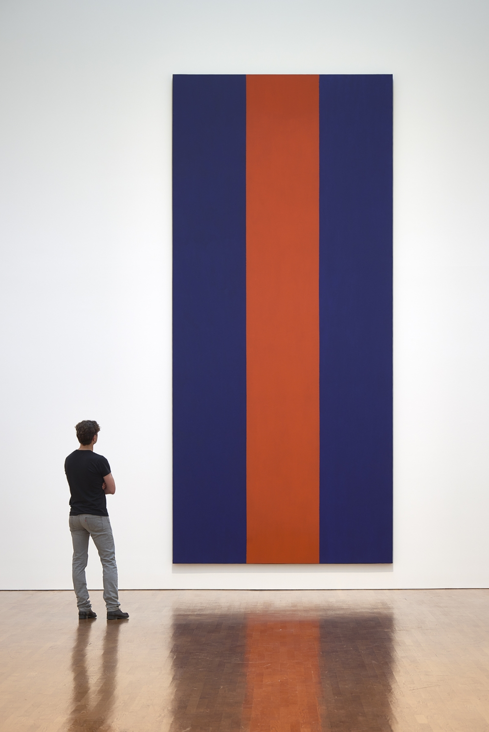
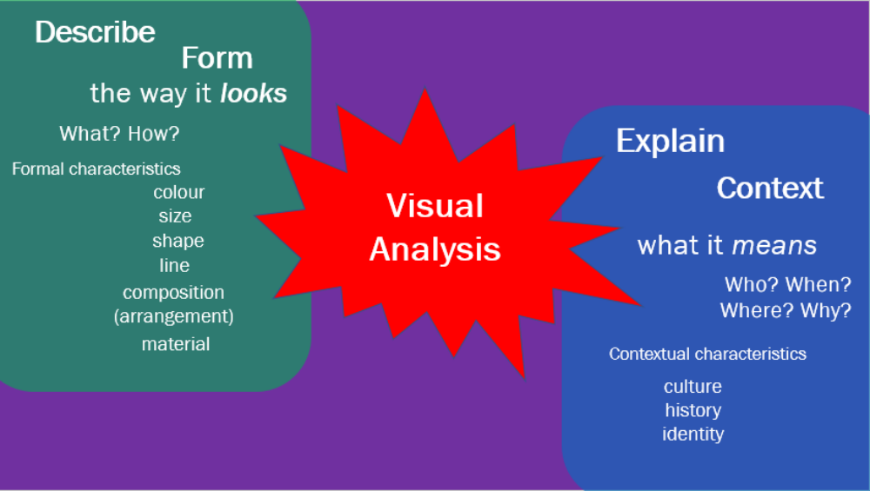
acrylic on canvas
commissioned
Expo ’67
Voice of Fire
Notes:
So, according to that definition, we can definitely call Barnett Newman’s painting abstract, right?
What’s going on here visually? 1. Let’s think back to our visual analysis and those “formal” characteristics: colour, size, shape, line, composition, and material. I’ll show you that slide again.
How would we describe each of these characteristics in Newman’s painting? Let’s try to be very detailed in our description. Let’s answer the ‘what’ and ‘how’ of this painting:
[pause]
Yes, that’s right. We have a very tall, narrow, rectangular canvas that’s 18 feet high, which has three vertical “stripes” in two colours painted on its surface: two dark blue stripes with one red one in the middle. All three stripes are the same width, and they go all the way to the top and all the way to the bottom of the canvas. What about material? It’s painted in 2. acrylic on canvas. It’s important to pay attention to material, too, because this can often have an impact on how a work of art looks. (We’re focusing on two paintings today, but there are also abstract sculptures, drawings, photographic works, and multi-media works that have lots of different materials.) So, what about the composition? (That’s the way that forms have been arranged in relation to one another). It’s a very simple composition, right?
I’m going to tell you a bit about the context of this painting, too – that other category of our visual analysis. Newman was 3. commissioned – that is, he was paid specially – to paint this work for 4. Expo ‘67, a huge international world’s fair exposition that took place in Montreal in 1967, where sixty different countries were represented by individual exhibitions. Newman’s painting was made for the United States pavilion, which featured an exhibition of works of art. This was the first time that Newman had painted something this big!

Slide 12
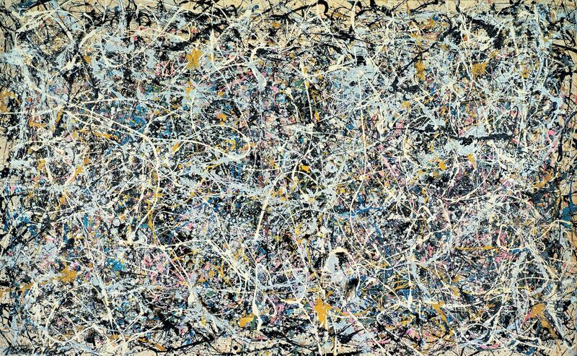
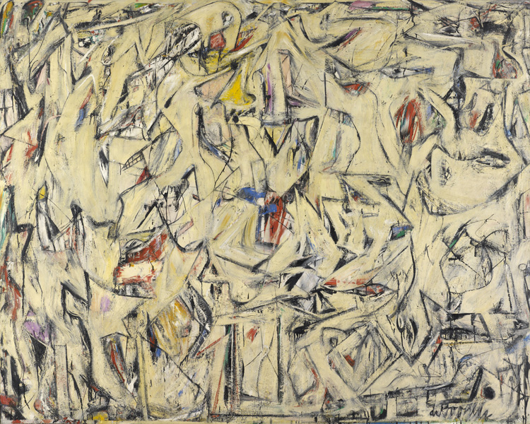
Abstract Expressionism
action painting
Jackson Pollock (1949) and Willem de Kooning (1950)
Voice of Fire
Notes:
Now, what if I told you the title of Newman’s painting? It’s called 1. ‘Voice of Fire’.
So, do you still think his painting is “abstract”?
[pause]
It is, isn’t it. But NOW you probably also have an image of something real in your mind: maybe a voice speaking to you, or the flame of a burning fire.
This is important. Now we find that there might be a bit of a grey area between “abstract” and “figurative” types of representation. If the title of Newman’s painting conjures up an image of something real in our minds, then perhaps even “abstract” art – which according to our earlier definition is non-figurative and non-realistic – might actually be able to represent something real, but do so in a different way.
This is one of the things that Newman was very interested in. He was one of a group of artists who practiced what we call 2. abstract expressionism, an art movement that began in New York City in the 1940s. In your class at school your teacher has already introduced you to some other artists from this movement, like Jackson Pollock and Willem de Kooning, who made the paintings I’m showing you here in 1949 and 1950. Abstract Expressionists were interested in the potential for non-figurative art to express real things, whether emotions, ideas, or even tangible things like a person – a figure! This art movement is associated with Western European artists, both in North America and Europe.
As you can see, there are different kinds of Abstract Expressionism: Pollock and De Kooning were what we call 3. action painters, who wanted their forms to be wildly and vividly expressive with lots of movement and variety. →

Slide 13
Abstract Expressionism
action painting
Jackson Pollock (1949) and Willem de Kooning (1950)
colour field painting
Notes:
Alongside the “action painters” were the colour field painters, like Newman!
They limited themselves to one or a few colours, which they laid out in large, usually flat areas.
But both action painters and colour field painters wanted to express something real through the use of abstract forms.
1. And both action painting and colour field painting are examples of Abstract Expressionism.

Slide 14
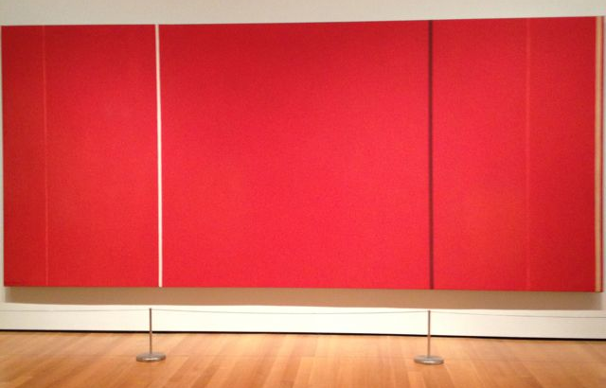
zip
Notes:
Colour field painters like Newman weren’t as gestural as the action painters; his lines are very controlled and precise. But they are still intended to evoke the impression of something real, and to prompt a very real emotional response in the viewer.
Many of Newman’s paintings look like this one on the right here, with long vertical lines or areas of colour divided by a single line, which he called a 1. ‘zip’ – kind of like a ‘zipper’! He saw this ‘zip’ as a way to create the impression of movement in the painting. He uses abstract forms – lines, shapes, and colours that don’t in themselves look like real, identifiable things – to conjure up an impression of something real in our minds. Here’s another example of a painting by Newman, from 1951.
Some visitors have said that they experience a strange optical illusion, when focusing their attention on the edges between the stripes – almost like the movement of a sound wave, or the illusion of heat waves vibrating over a hot pavement – which might be another way to interpret the “voice” in the painting’s title.

Slide 15
Barnett Newman
1967
New York City
Montreal
Vietnam War (1955-1975)
Voice of Fire
Notes:
Why did he call this painting “Voice of Fire”? Well, here’s where that other part of our “visual analysis” approach comes into play! We have to find out a bit more about the context of the painting. Let’s take a look at that earlier slide again.
So, we already know ‘who, when, and where’: 1. Barnett Newman, in 1967, in New York City (where it was painted) and Montreal (where it was first displayed). And now it’s here in Ottawa in the National Gallery of Canada.
What about ‘why’? This is a tricky one that requires us to do some research into the historical moment that the painting was made, and to find out more about the artist’s own intentions, if they are known.
Fortunately for us, we do have quite a lot of information to help us understand this broader context, which can help us better understand the meaning of the painting:
Does anyone know what was happening in the world in 1967?
That was the height of the 2. Vietnam War, a conflict between North Vietnam and South Vietnam that lasted for twenty years - from 1955 to 1975. As many of you will have already learned in your history class, the United States was heavily involved in this war and suffered an enormous loss of life, which prompted many protests within the US and all over the world by people who felt that the US should not be involved. Newman was deeply affected by the war and its consequences at the time he made this painting. Knowing this, we might interpret the painting’s red ‘zip’ in connection with the painting’s title – is it perhaps a flame, like those created by bombs falling to the ground? It’s been suggested that Newman intended this painting as his own form of protest of the US involvement in the war.
Knowing all of this, we can see that Newman intended his painting to prompt an emotional response in us. He wanted to represent something very real, but to do so with the use of a type of representation that is much more abstract than it is figurative.
Many people who look at this painting without this contextual knowledge don’t find it interesting. They dismiss it as child-like (some say even a child could have painted it!) or they find it confusing. Why, they ask, would someone just paint three giant stripes on a canvas?
BUT when we take a minute to ask questions about context, to find out some facts about the culture, history and identities around the painting, we start to understand and maybe even consider a work of art like this to have profound cultural significance and value.

Slide 16
representation
abstract, abstraction
figurative
visual analysis (form, context)
Abstract Expressionism
(action painting, colour field painting)
Key Terms
Notes:
So, let’s pause for a minute and review some of the key terms we’ve learned thus far:
representation
abstract (or abstraction, the noun form)
figurative
visual analysis (concerned with form and context)
And we’ve also learned a bit about one particular movement in the Western (North American and European) history of abstract art, known as Abstract Expressionism, and two types of Abstract Expressionism: action painting and colour field painting.

Slide 17
scale
Notes:
As I hope you can see already from the examples we’ve been looking at, artists can engage in abstract representation in various ways, and to varying degrees.
The same is true of figurative representation.
Let’s come back to Norval Morrisseau’s painting and think about how it compares to Newman’s.
When we did our opening activity, some of you said you thought this painting wasn’t “abstract” because you could identify recognizable things, like birds and people.
1. Let’s push this a bit further, and use our visual analysis skills to be a bit more precise with our language.
How would we describe the painting’s formal characteristics?
[pause]
Yes, it’s VERY colourful! There are lots of different shapes, of varying sizes. We could also talk about 2. scale (let’s add that to our list!), or the relative size of shapes to one another. We have large figures and small figures, the contrast between them suggesting a kind of spatial depth, as though some figures are in the foreground and others in the background. There are varieties of line, although a thick black line is a notable feature throughout the image. A very dense composition, filled with elements – much more complex than Newman’s. The material is, interestingly, the same as Newman’s – it’s acrylic paint on canvas.

Slide 18
Notes:
When we compare Morrisseau’s painting to Newman’s, we can see the clear difference between the degree of “figurative” and “abstract” types of representation.
Morrisseau’s is much more figurative, and Newman’s is much more abstract.

Slide 19
plays with proportions (disproportionate)
elongated (attenuated) limbs
flatness, emphasis on surface of image
unusual or unexpected effects of scale
strong emphasis on line (linear)
areas of colour are flat, with no variation or shadows
colours are very bright, not quite realistic
Notes:
BUT, some of you noted earlier that you felt Morrisseau’s painting was very abstract, as the figures don’t quite look real.
Can we elaborate on this a little further? What is it that makes them appear abstract?
[pause]
Yes, they have very spindly arms and legs!
The artist is doing various things here that engage with abstraction:
1. He plays with proportions, creating “disproportionate” relationships between body parts.
2. The limbs of the figures are elongated, attenuated, or drawn-out and thin at their tips, which is not the way that human or animals limbs are in reality.
3. The surface of the painting also looks very flat, doesn’t it? As though all of the figures have been placed on the surface itself, rather than occupying a convincing three-dimensional space.
4. So scale is also being played with here – we have small figures right next to big ones, which is unexpected.
5. Also contributing to this 2-dimensional effect is a strong emphasis on line, or what we call a ‘linear’ style.
6. The colours are also very flat and uniform, and there are no shadows.
7. And they’re very bright colours, too – not entirely naturalistic.
In a way, we can think about Morrisseau’s painting as very similar to Newman’s painting, in its use of areas of flat, single colours. We might even suggest that Morrisseau’s painting be linked to that ‘colour field’ type of abstract expressionism. →

Slide 20
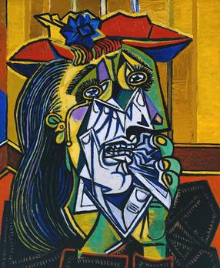
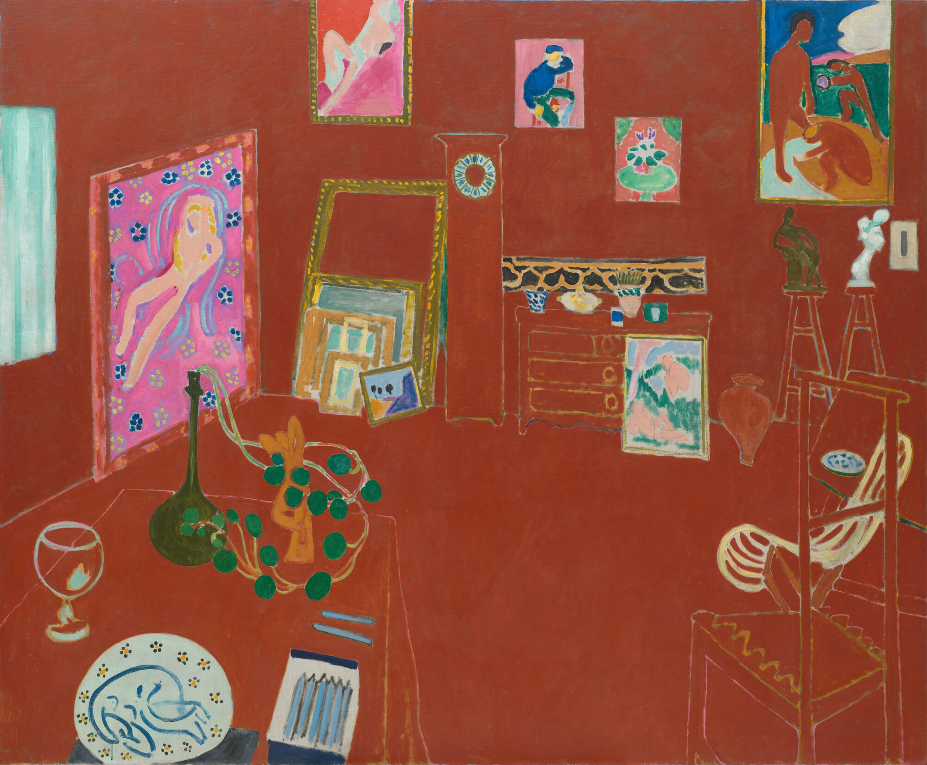
Ojibwa (Ojibwe)
Pablo Picasso
Artist and Shaman between Two Worlds
Henri Matisse
Notes:
BUT here’s where we have to be a bit careful and also put on our “context” hats!
When we compare works of art, sometimes it’s tempting to lump them together under the same categories. Just like we do when we size up people and draw conclusions about them on the basis of a first impression, we can make assumptions about works of art that aren’t always helpful or correct. Here’s where that “visual analysis” approach comes in handy.
Let’s find out more about the context of Morrisseau’s painting:
The title of this painting is 1. “Artist and Shaman between Two Worlds”.
Now that we know that, just like we did with Newman’s painting, we have some more idea of context. The title suggests to us that the central figure might be the artist, or a shaman (or perhaps both?), and that there are “two worlds” represented in the image.
Before we get to that, though, let’s try and answer the other “context” questions of who, when, where, and why:
Morrisseau, or Copper Thunderbird, was one of the most important and influential Indigenous artists of the twentieth century. 2. His cultural identity is that of Ojibwe people, whose traditional lands occupy an area of Canada and the US around the Great Lakes. He was, himself, influenced by artists like Newman, who belonged to the generation before him and worked in abstract styles of painting. But he also reacted against the styles and techniques of contemporary abstract artists to create a visual language that drew from the artistic traditions of his own culture. His influences were diverse. 3. They included artists who began experimenting with blending abstract and figurative forms in the early 20th century, like Pablo Picasso and Henri Matisse (their work was also very influential on Barnett Newman). →

Slide 21
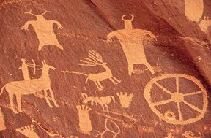
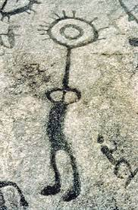
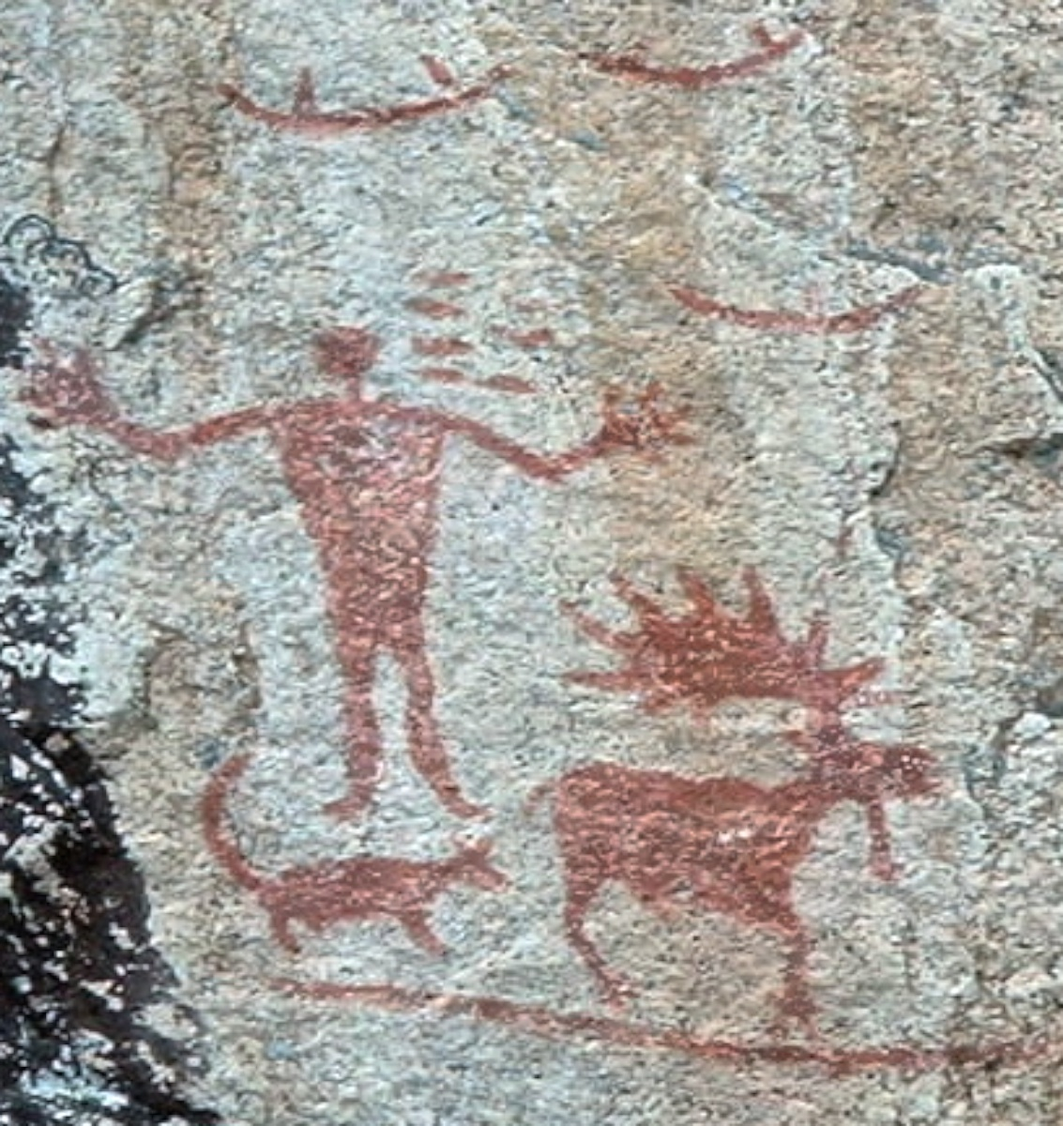
abstract things we can’t recognize, or that don’t look real
Prehistoric carved and painted pictographs and petroglyphs of the Ojibwe (Anishinaabe) people of Canada and the northern United States
Notes:
BUT Morrisseau was also – very importantly – strongly influenced by the artistic traditions of his own Indigenous culture.
And this is where our consideration of “context” requires us to also take into account different cultural interpretations and visual traditions of “abstraction”.
When we look back at the history of art, artists have engaged in an “abstract” type of representation for lots of different reasons, and in lots of different ways.
1. One of the Indigenous artistic traditions that Morrisseau wanted to incorporate and celebrate in his own art was the prehistoric tradition of the pictograph and petroglyphs, painted and carved symbols used to indicate words or phrases. These symbols are themselves both figurative and the abstract: they look like a bit like real things – people, animals, plants – but they play with proportions and scale, are rendered in flat areas of colour, and make a very strong use of line. We can see examples of these symbols in rock art, which we find in Canada and the northern US.
To the prehistoric Indigenous artist who made these images, however, and to a modern Indigenous artist like Morrisseau, these symbols have profound and very “real” meaning: they represent beings and forces with powers and abilities that have a very real influence on our lived reality. So, for us to call them “abstract”, according to our earlier definition (remember – we defined “abstract” as things that aren’t real or recognizable), would be insensitive to certain other cultural understandings or interpretations of how these symbols perform in the lives of people.
This, then, is a different cultural interpretation of abstract representation.

Slide 22
cultural awareness
I transmit astral plane harmonies through my brushes into the physical plane. These otherworld colours are reflected in the alphabet of nature, a grammar in which the symbols are plants, animals, birds, fishes, earth and sky.
abstract
things we can’t recognize, or that don’t look real
Artist and Shaman between Two Worlds
Notes:
Let’s go back to the first part of that quote from Morrisseau that I read to you earlier:
1. “I transmit astral plane harmonies through my brushes into the physical plane. These otherworld colours are reflected in the alphabet of nature, a grammar in which the symbols are plants, animals, birds, fishes, earth and sky.”
Now that we know some of the context around Morrisseau’s art, we have a better understanding of what he means – and what his painting is about: 2. this is an image of Morrisseau (the artist) as a shaman, himself, acting as a mediator between the real and the spiritual worlds.
3. Is our earlier definition of “abstract” still useful for Morrisseau’s painting? What do you think?
[pause]
Yes, we can certainly talk about Morrisseau’s art as being “abstract,” according to our earlier, Western definition. That’s certainly not wrong! But when we know that a culture or individual person has a slightly different use for or interpretation of abstraction, we have to choose our words very carefully and demonstrate 4. cultural awareness. If we were writing or speaking about Morrisseau’s painting as “abstract”, we might have to explain exactly what we mean by that, according to his own cultural tradition.
This is something for you to keep in mind when looking at any work of art.

Slide 23
Handout with key terms
Is the work of art abstract, and if so, in what ways?
Use some of the vocabulary from today’s lesson as part of your visual analysis.
Think about how your work of art relates to the paintings by
Newman and Morrisseau.
representation
abstract, abstraction
figurative
Abstract Expressionism
(action painting, colour field painting)
visual analysis
form: colour, size, shape, line,
composition, material, scale, proportion, surface, elongated (attenuated), line (linear)
context: culture, history, identity
cultural awareness
Notes:
Now that you’ve learned a bit about abstract art, and some of the key terms that we use when conducting a visual analysis of art of this kind, we’re going to do a fun activity and give you a chance to put your new skills into practice!
You’re going to break into smaller groups or 3 or 4 and spend some time with another work of art in the gallery. I’ve given you a handout with one question on it.
1. Is the work of art is abstract, and if so, in what ways?
In answering this question, I want you to:
2. Be sure to use some of the vocabulary from today’s lesson as part of your visual analysis.
3. Think about how your work of art relates to the paintings by Newman and Morrisseau.
I want you to spend some time looking carefully at the work of art and talk with your team members about what you see. You’ll have 15 minutes with your group. Write down your answers on the handout, and then we’ll all come back together and one person from each group will share your responses. If you have any questions as you go, please come and ask me or your teacher and we’ll help you out. We’ll also have some time at the end of our activity to answer any more questions you might have. Don’t worry about being ‘right’ or ‘wrong’ – this is just an opportunity for you to start to get used to using these terms!
You’ll see a number at the top of your handout and the name of a work of art in the gallery for you to work with – find your buddies who have the same number and team up.
I’ve also given you a list of the key terms we’ve discussed so far – this is the ‘vocabulary’ I’d like you to try and incorporate into your analysis. You don’t have to use every single word! You need to decide which words are relevant to the work of art you’re analysing. When you do your visual analysis, you can also focus on form, rather than context, since you aren’t expected to know the history behind the work of art. But if you have questions about this then please come and ask!
Have fun, and I look forward to hearing what you come up with!

